Slide 1
Hong Kong Horses
Ismail Harti, Ryan Helmlinger, Rustam Ibragimov, Rohan Kheterpal & Matthew Lewis

Slide 2



Which horse to bet on at Hong Kong race tracks? Can data provide an edge for betting?
Notes:
The public dataset was obtained from kaggle and included almost 80k observations of 48 salients varubales.

Slide 3

Initial Data Cleaning
Removal of low value columns
Selection of relevant data
NA removal through imputation
New labels
Removal of obviously predictive columns (binary win & rank)

Slide 4
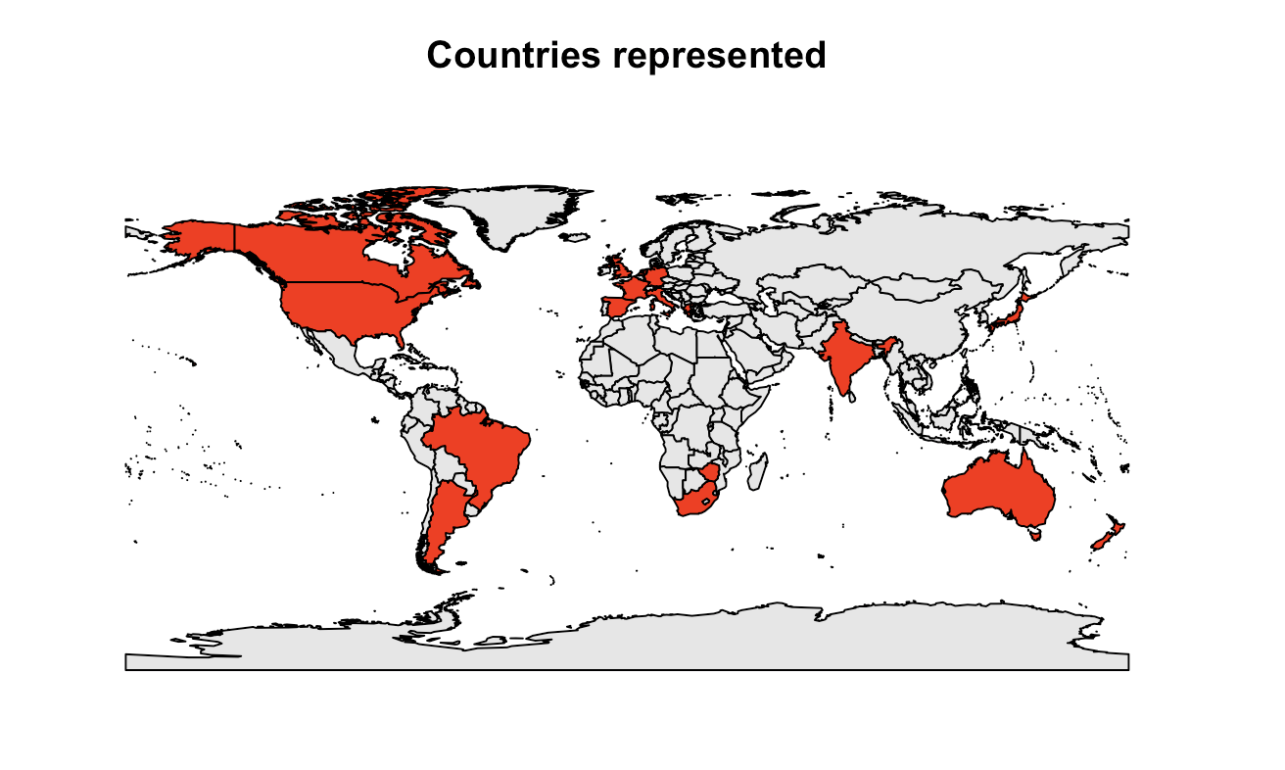
Horses come from all over the world, with 17 countries represented.

Slide 5
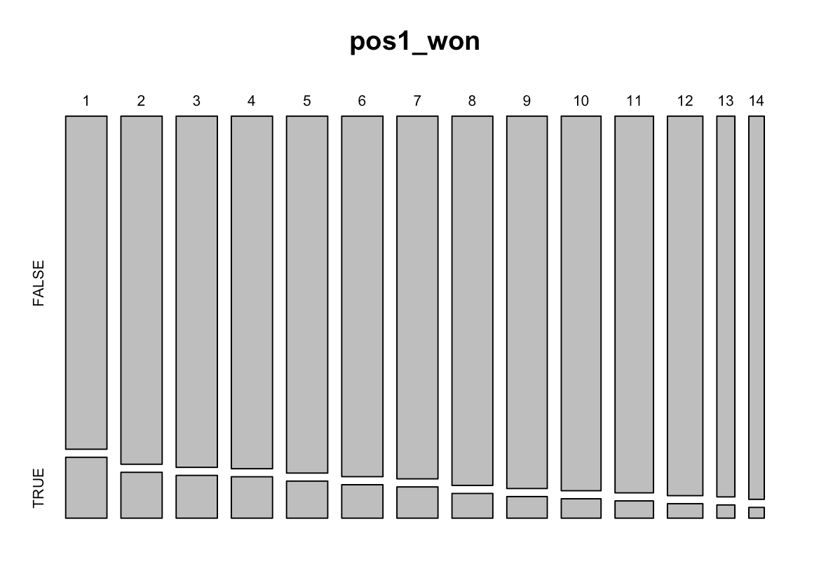
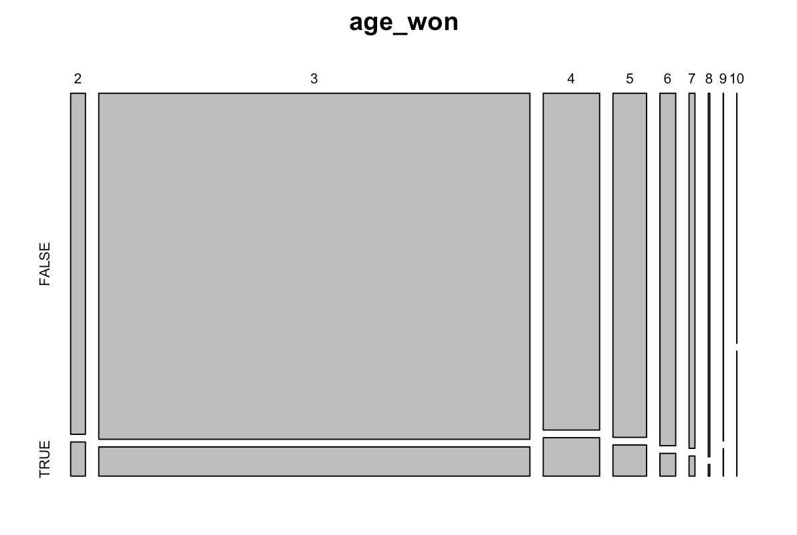
Horses that start the race in the lead are more likely to end in the lead. Additionally, prime age is around 4 years old.

Slide 6
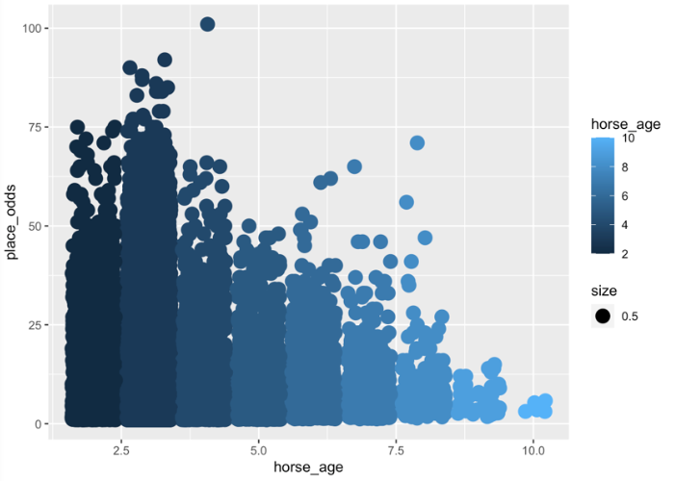
As horses age, their odds drop. With highest odds around 3 years old.
*Note: While most horses were age 3, the winningest age was actually 4.

Slide 7
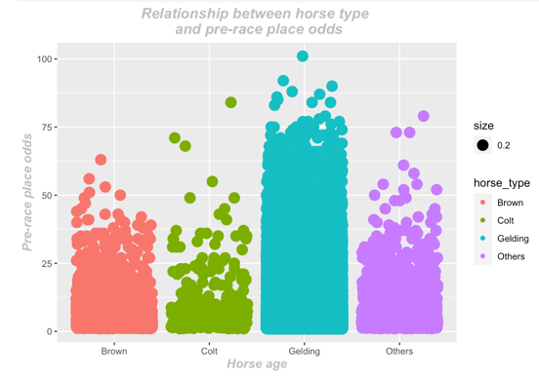
Gelding horses, shown in aquamarine, have higher place odds.
Notes:
Next slide should look at if geldings actually win more….

Slide 8
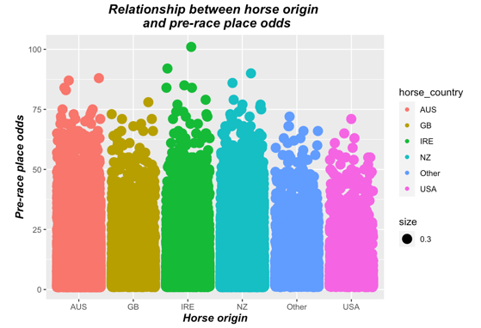
Place odds based on horse origin country

Slide 9
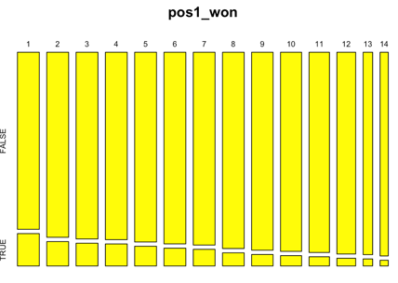
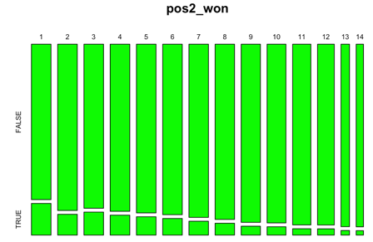
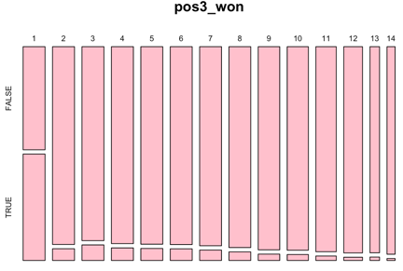
Fastest out of the gate often means fastest throughout. First place leads changes are uncommon.

Slide 10
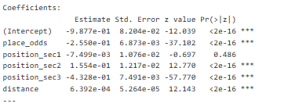
Logistic Regression
Most significant variables:
place_odds ↓
declared_weight ↑
draw ↓
jockey_id →
horse_country →
age ↑
Notes:
The arrows indicate the sign on the regression estimate. The sideways ones are ones that don't have a strong regression direction, but still correlate to race results strongly.

Slide 11
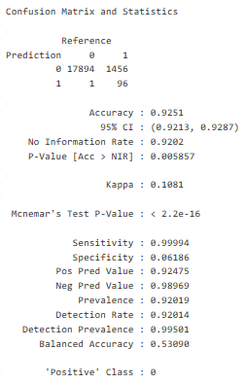
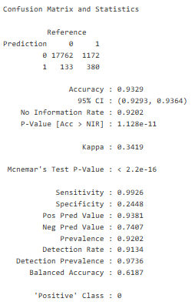
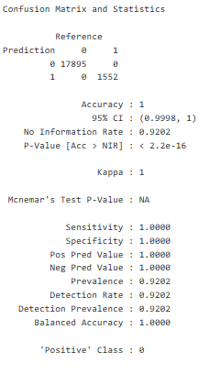
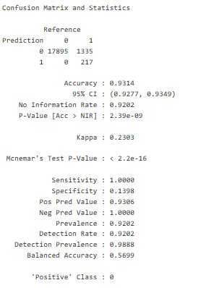
ANN and DT models proved most accurate attaining 100%
SVM model
kNN model
ANN / DT model
Combined model
Notes:
Proceeding from the logistic regressionm, we ran support vector models, k nearest neighbor, nuruel net, and decison tree models. As well as a combined simple voting model. Of these, the neural net and decsion tree models proved most accurate, attaining 100% accuracy prior to boosting. We suspect that the inaccuracy introduced in our combined model was from our support vector output. Here you can see all model outputs, where accuracy is highlighted in green and the kappa statistic in red...

Slide 12
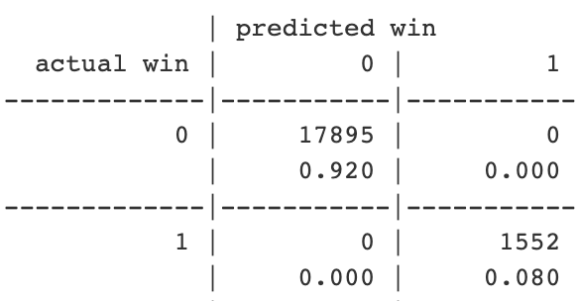
Improvement methodology for models
Boosting
All models attained 100% accuracy under boosted conditions.
Error costing
Error costing should still be applied to a completely accurate model to avoid costly false negatives.
Notes:
Our team looked to two methods for model improvement: boosting and error costing. All models achieved 100% accuracy with boosting. While no false predictions were attained with our models we would still recommend implementing error costing in order to ensure no costly false positives could be introduced.

Slide 13

Strategic betting elements
The horse should be **4 years old** as they have the highest proportional chance of winning.
The horse should be of **Argentinian** or **South African** background.
The horse should have a tendency to be **leading** heading into the **final stretch**.
The horse should have a tendency to get a **quick start out of the gate**.
The horse should have **fairly low odds**, in order to increase arbitrage opportunities.
Notes:
Our analysis provides insight into strategic betting with 5 main takeaways. The horse should be 4 years old, of argentiain or south african origin. The horse should be leading into the final stretch of the course and should have a quick start out of the gate. We recommend selecting a horse with these characteristcs that has relativly low odds in order to increase arbitrage oppurtunity and payout.
If given more time, our team would have liked to further explore how the course calculates odds and would have conducted our own odds calculation in order to better inform betting. Thank you for listening!

Slide 14
Thank you!
Ismail Harti, Ryan Helmlinger, Rustam Ibragimov, Rohan Kheterpal & Matthew Lewis

